Slide 1
CREATIVE ARTS
GRADE 8
REVISED CURRICULUM AND ASSESSMENT PLANS
Implementation June 2020

Slide 2
Presentation Outline
Purpose
When will I teach?
What will I teach?
How will I teach and assess?
Reorganisation of Content Topics for the Phase
Amendments to the Annual Teaching Plan
Amendments of School Based Assessment (SBA)
Conclusion

Slide 3
Purpose
To mediate the amendments of the trimmed and reorganised 2020 Annual Teaching Plan for Creative Arts, Grade 7-9 as stipulated in Circular S2 of 2020.
To ensure that meaningful teaching proceeds during the remaining teaching time as per the revised school calendar.
To assist teachers with guided pacing and sequencing of curriculum content and assessment.

Slide 4
Purpose (continued)
To enable teachers to cover the essential core content /skills in each grade within the available time.
To assist teachers with planning for the different forms of assessment.
To ensure learners are adequately prepared for the subsequent year/s in terms of content, skills, knowledge, attitudes and values.

Slide 5

When, What and How of Adapted Creative Arts Teaching Plans
How much teaching time do I have?
Term 2: 20 July – 24 July **1 week**
Term 3: 3 August – 23 September **8 weeks**
Term 4: 28 September – 9 December **7 weeks**
      (exam starts in week of 16 November)

Slide 6

When, What and How of Adapted
Creative Arts Teaching Plans
What do I teach?
Revised Teaching and Assessment Plans
  (TAPS) based on Creative Arts CAPS (trimmed & reorganized)

Slide 7
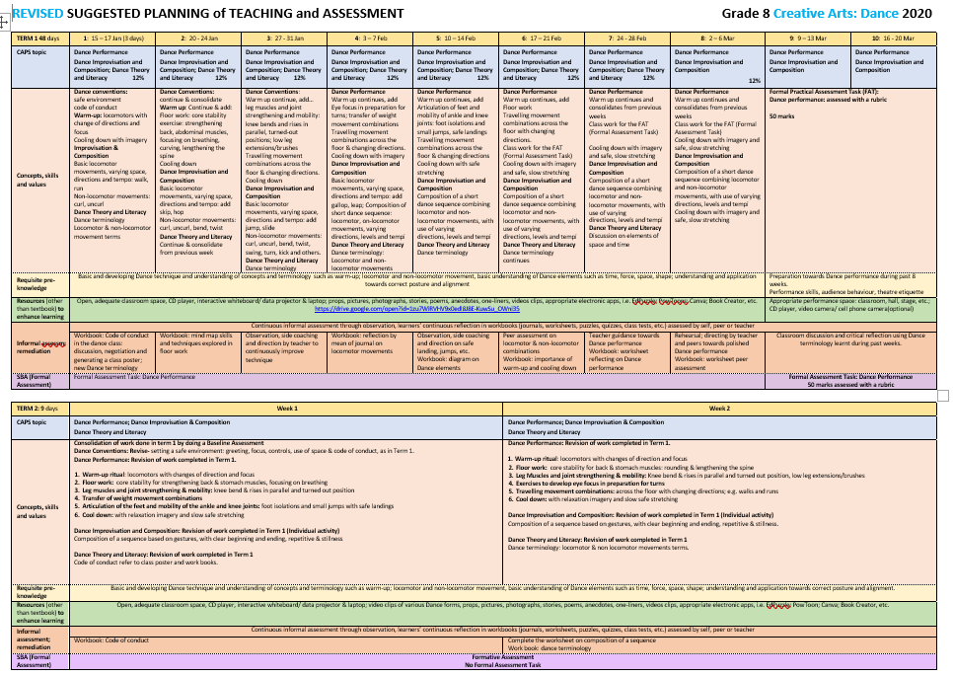

Slide 8
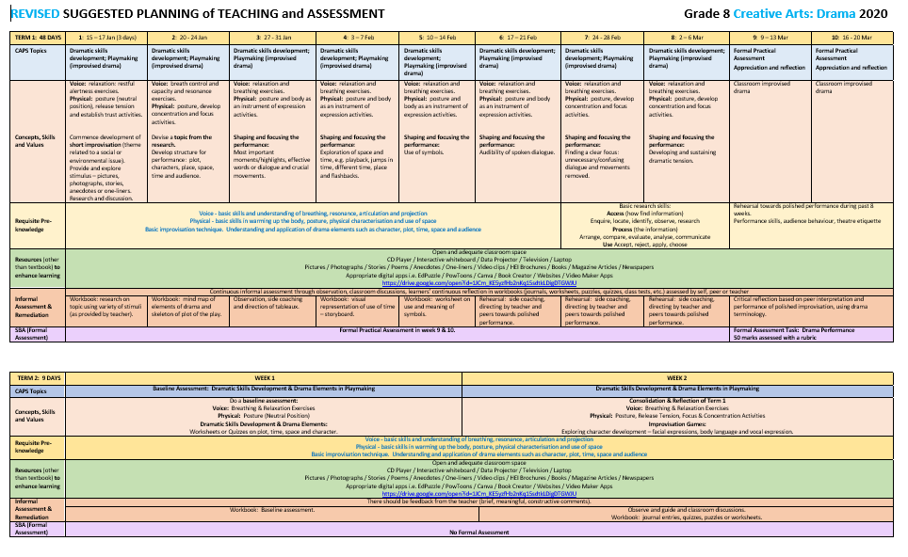

Slide 9
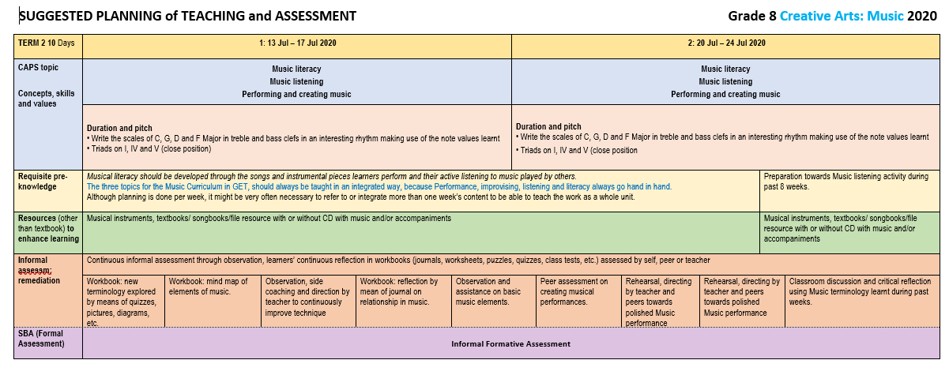

Slide 10
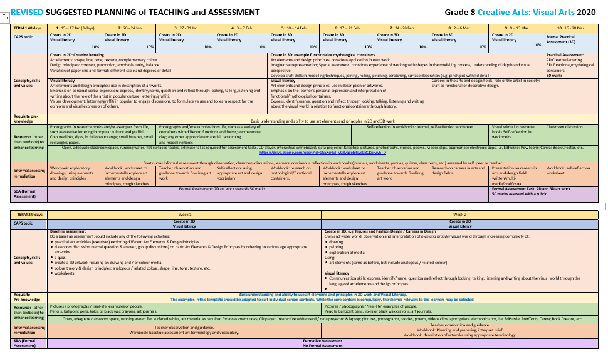

Slide 11

When, What and How of Adapted
Creative Arts Teaching Plans
What do I assess?
Term 2: No formal assessment for recording purposes. Formative Assessment
**Assessment FOR learning**
Term 3: Formal Assessment: Practical Task per Art Form
50 marks per art form
Term 4: Written Test/Exam per Art Form
50 marks per art form

Slide 12

When, What and How of adapted
Creative Arts Teaching Plans
How do I teach during the time of COVID 19?
Adhere to COVID-19 requirements
When sick, stay at home.
Always wear a mask - also in practical lessons.
Practise social distancing.
Be screened.
Use own teaching & learning materials.
Ensure health and safety of staff and learners
Respect yourself and others.
Accept COVID-19 as a reality.
Develop a growth mind-set.
Acknowledge difficulties & seek professional help.
Support others who are struggling.
Provide psycho-social support

Slide 13

General Guidelines for all
Art Forms
Learners 1.5m apart from each other during the lesson at all times.
Provide physical guides - tape on floors, signs on walls.
Masks are worn at all times.
Hands washed/sanitised before entering classroom.
If in Dance/Drama room, clean socks pre-lesson, socks removed post lesson and placed in plastic bag.
Sanitise floor post lesson if socks are not worn.
Sanitise classroom before and after lesson.
Ensure room is well-ventilated.
The physical space expanded - making use of nearby libraries, community halls, leisure centres, churches, etc.

Slide 14

continues….
DANCE: taught according to TAPS with a theoretical and practical component
learners guided/monitored - mask fits well, at all times.
use biggest available space.
split classes to allow for space between learners.
timetable adjustments for split classes (possibly 30 minutes per group if groups is split in half).
floor sanitised after each lesson.
clean socks pre lesson, socks removed post-lesson.
no contact/group work/partner work.
refrain from aerobic and strenuous activity – impact on breathing.
explore chair/desk dances/ creative exploration of limited space/axial movement, etc.
online resources: video and audio clips.

Slide 15
continues….
DRAMA: taught according to TAPS with a theoretical & practical component
learners guided/monitored - mask fits well, at all times.
split classes to allow for space between learners.
timetable adjustments for split classes (possibly 30 minutes per group if groups is split in half).
no group work – select individual performances where possible.
focus on individual performances.
explore creative use of space, themes related to social, emotional issues of COVID 19.
online resources: video and audio clips – listening activities.

Slide 16
continues….
MUSIC: according to TAPS with a theoretical & practical component
learners guided/monitored - mask fits well, at all times.
no sharing of instruments, e.g. guitar, drums, etc.
no teaching of wind and brass instruments (masks)
added risk: breath is aerosolized/forcefully ejected when playing.
split classes to allow for space between learners.
timetable adjustments for split classes (possibly 30 minutes per group if groups is split in half).
focus on individual performances.
online resources: video and audio clips – listening activities.

Slide 17
continues….
VISUAL ARTS: taught according to TAPS with a theoretical and practical
component
learners guided/monitored - mask fits well, at all times.
split classes to allow for space between learners.
timetable adjustments for split classes (possibly 30 minutes per group if groups is split in half).
no sharing items (brushes, pencils, crayons, etc.)
keep each learners’ art material in individually labeled containers – if learners can provide their own.
online resources: video and audio clips – listening activities.
explore themes related to COVID 19 in art works.

Slide 18
when no space is available…
TEACHER’S ROLE
Follow the adapted TAPS.
Use and/or adapt WCED designed lesson plans per week. This will lessen stress and workload.
Demonstrate practical skills in class.
Make use of digital resources i.e. show video or audio clips if possible.
Guide and explain lesson plan to learners.
Answer and explain any questions that learners might have.
Work through worksheets or written activities.
Motivate and stress the importance of repetition and practise of skills at home.
Keep learners inspired and motivated to complete tasks at home.
Online classes to support and guide learners with practical skills.

Slide 19
when no space is available continues…
LEARNER’S ROLE
Receives written lesson plan in hard copy OR via WhatsApp OR Google Classroom etc.
Practise in class: limited practical skills with teacher that can be done at a desk: e.g. Dance - stand up and do a spinal roll. Drama - vocal warm-ups. Music - tapping beats/rhythms on desks. Visual Art - drawings with own pencil, etc.
No sharing of any art equipment or musical instruments.
Practise all performance skills at home in preparation for the next lesson.
Complete written activities at home in preparation for the next lesson.
Optional: attend online classes with teacher for support and guidance.

Slide 20
Assessment and Moderation
Learners doing practical at home
Video footage of all practical tasks (performance) provided for assessment. To be up and downloaded at school.
Footage to be retained as evidence for moderation by the province, DBE.
Visual Art: photographic evidence as per teacher’s guidelines.
Learners doing practical at school
Practical assessment scheduled for last two weeks of Term 3.
Timetable per class group: learners assessed in small groups dependent on space, maintaining social distancing.
Mainly individual performances.
Visual Art: assessment of art works / photographic evidence.

Slide 21
Now that you know all the essentials of When, What and How you must teach, it is time to see how the curriculum was reorganised.

Slide 22
Reorganisation
Content Topics for the Phase

Slide 23
Reorganisation of Content Topics: Dance
Click on the link below to follow the process of how reduced content was integrated into other topics where appropriate:
https://drive.google.com/open?id=1UAQS93S85rkts1ZNyepQt3R4qBrPIpY_

Slide 24
Reorganisation of Content Topics: Drama
Click on the link below to follow the process of how reduced content was integrated into other topics where appropriate:
https://drive.google.com/open?id=1PxHf-Pb0kS6uFoA7ZtYaMweXRU65XKgX

Slide 25
Reorganisation of Content Topics: Music
Click on the link below to follow the process of how reduced content was integrated into other topics where appropriate:
https://drive.google.com/open?id=1voXR6KIb6ZE3GNMx6IBMFwcRLbkLJL1n

Slide 26
Reorganisation of Content Topics: Visual Art
Click on the link below to follow the process of how reduced content was integrated into other topics where appropriate:
https://drive.google.com/open?id=1l8llyiRlSkKkDtiyXPfs3LPR9hY2Cs95

Slide 27
Amendments
Annual Teaching Plan

Slide 28
Amended Content/Topics
Grade 8 Dance
Content/Topics | Term | Amendment
Baseline Assessment Topic 1: Dance Performance Topic 2: Dance Improvisation & Composition Topic 3: Dance theory and Literacy | 2 | Complete reduction and therefore adaptation of Term 2 due to the fact that learners will possibly only have a 1/2 lesson/s for the term. The purpose of a baseline assessment is to measure the level of learners’ skills and knowledge in Drama before teaching and learning for the term commences. It highlights strengths and areas for improvement so teachers are aware of every individual's requirements.

Slide 29
Amended Content/Topics
Grade 8 Dance
Content/Topics | Term | Amendment
Topic 1: Dance Performance Topic 2: Dance Improvisation & Composition Topic 3: Dance Theory and Literacy | 3 | Topic 1: Arm movement, positions and sequences reorganised - in other activities. Turns on one leg with eye focus has been integrated with transfer of weight. Learning a short group dance focusing on team work and presentation skills have been removed and replaced. Topic 2: Remains as stipulated in CAPS. Topic 3: Discussion of a dance seen in the community, on television or on stage is replaced.

Slide 30
Amended Content/Topics
Grade 8 Dance
Content/Topics | Term | Amendment
Topic 1: Dance Performance Topic 2: Dance Improvisation & Composition Topic 3: Dance Theory and Literacy | 4 | Topic 1: Consolidation of the work as indicated in Term 3 of the Revised ATP. Topic 3: Revision of the work completed in Term 3 as indicated in the revised ATP.

Slide 31
Amended Content/Topics
Grade 8 Drama
Content/Topics | Term | Amendment
Baseline Assessment Topic 1: Dramatic Skills Development Topic 2: Drama elements in playmaking | 2 | The purpose of a baseline assessment is to measure the level of learners’ skills and knowledge in Drama before teaching and learning for the term commences. It highlights strengths and areas for improvement so teachers are aware of every individual's requirements.
Topic 1: Dramatic Skills Development Topic 3: Interpretation and Performance of Dramatic Forms: Poetry/Praise Poetry | 3 | Content and skills of term 2 integrated and scaffolded within the content of term 3. Topic 1: Reduced physical and vocal exercises. Topic 3: Reduced choice of Performance. Topic 5: Removed and integrated with topic 3.
Topic 1: Dramatic Skills Development Topic 2: Drama Elements Topic 3: Interpretation and Performance of Selected Dramatic Forms: Dialogues | 4 | Integration/Combine: Term 3 and 4. Topic 1: Reduced physical, vocal exercises Topic 2: Removed improvisation, themes and research Topic 3: Reduced choice of performance. Topic 4: Removed & integrated with topic 3.

Slide 32
Amended Content/Topics
Grade 8 Music
Content/Topics | Term | Amendment
Baseline Assessment Topic 1: Music literacy Topic 2: Music listening Topic 3: Performing and creating music | 2 | Content in Term 1 & 2 was compared and repetitions were identified. Removed content which was covered in Term 1 and can be done away with in Term 2.
Topic 1: Music literacy Topic 2: Music listening Topic 3: Performing and creating music | 3 | Content in Term 2 & 3 was compared and repetitions were identified. Removed content which was covered in Term 2 and can be done away with in Term 3.
Topic 1: Music literacy Topic 2: Music listening Topic 3: Performing and creating music | 4 | Topic 1 has been left as it consolidates what has been taught and learned in Terms 1- 3. Content in Term 3 & 4 was compared repetitions were identified. Removed content that was covered in Term 3.

Slide 33
Amended Content/Topics
Grade 8 Visual Art
Topics | Term | Amendment
Baseline Assessment Topic 3: Visual Literacy | Term 2 | Baseline Assessment. The purpose of baseline assessment is to measure the level of learners’ skills and knowledge in Visual Art before teaching and learning for the term commences. It highlights strengths and areas for improvement so teachers are aware of every individual's requirements.
Topic 1: Create in 2D Topic 2: Create in 3D Topic 3: Visual Literacy | Term 3 | Topic 3: Visual Literacy: Implement into every lesson through various exercises that integrate the Art Elements & Design Principles over the course of the term. These exercises are the core of what is needed for progression. Focus on combining the 2D &3D activities into one task for the term by creating a mixed media artwork that includes the required Art Elements & Design Principles.
Topic 1: Create in 2D Topic 2: Create in 3D Topic 3: Visual Literacy | Term 4 | Topic 3: Visual Literacy: Implement into every lesson through various exercises that integrate the Art Elements & Design Principles over the course of the term. These exercises are the core of what is needed for progression. Focus on combining the 2D activities into one task for the term by creating a mixed media artwork that includes the required Art Elements & Design Principles.

Slide 34
Amendments
School Based Assessment (SBA)

Slide 35
Revised
Programme of Assessment: Grade 8
Formal Assessments (SBA during the year) |  |  | End-of-year examination
200 ÷ 2.5 = 80 marks (80%) |  |  | 100 ÷ 5 = 20 marks (20%)
Assessment of practical work in TWO art forms - 200 marks (80%) |  |  | Written examination – 100 (20%)
Assessment per Term
TERM 1 | TERM 2 | TERM 3 | TERM 4
Practical Assessment Art Form 1: 50 marks (20%) Art Form 2: 50 marks (20%) Total: 100 marks (40%) | Practical Task Informal Formative Assessment. | Practical Assessment Art Form 1: 50 marks (20%) Art Form 2: 50 marks (20%) Total: 100 marks (40%) | Written Examination Art Form 1: 50 marks (10%) Art Form 2: 50 marks (10%) Revision of the year’s work for formal assessment. 30% of each exam paper should be based on applied competence: reflection and practical application questions Total: 100 marks (20%) Practical tasks: Informal Formative Assessment

Slide 36
Revised
Practical Assessment Task
Practical tasks are formally assessed in
Term 1 & 3.
Practical Activities in Term 2 & 4 serve as Formative Tasks and will not be formally assessed.
The practical skills and content will be assessed in the written test/exam in Term 4.

Slide 37
CONCLUSION

Slide 38


